Slide 1
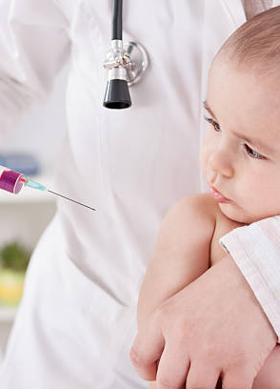

CHILD VACCINATION MANAGEMENT
PRESENTED BY:
KAVYA HEGDE
VINODA PATIL

Slide 2
INTRODUCTION
Right from birth till the age of 12 years the child will be vulnerable to a host of diseases, viruses and bacteria at such tender age. The body of the child may not have the required immune system to protect them from the diseases so make sure that children have access to proper healthcare and immunization against diseases. this system helps parents book vaccination appointment for their children with just few clicks.

Slide 3
Birth | BCG, Hep B1, OPV
6 weeks | DTWP /DTaP1, Hib-1, IPV-1, Hep B2, PCV 1,Rota-1
10 weeks | DTWP /DTaP2, Hib-2, IPV-2, Hep B3, PCV 2, Rota-2
14Weeks | DTWP /DTaP3, Hib-3, IPV-3, Hep B4, PCV 3, Rota-3*
6 Months | Influenza-1
7 Months | Influenza -2
6 – 9 Months | Typhoid Conjugate Vaccine
9 Months | MMR 1 (Mumps, measles, Rubella)
12 Months | Hepatitis A- 1
12 – 15 Months | PCV Booster
15 Months | MMR 2, Varicella
16 – 18 Months | DTwP /DTaP, Hib, IPV
18 – 19 Months | Hepatitis A- 2**, Varicella 2
4 – 6 years | DTwP /DTaP, IPV, MMR 3
9 – 15years (Girls) | HPV (2 doses)
10 – 12 Years | Tdap/ Td
2nd, 3rd, 4th and 5th Year | Annual Influenza Vaccine

Slide 4
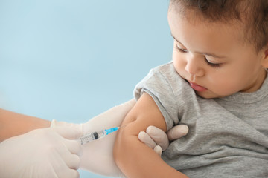
OBJECTIVE:
This website is provides the user easily they can book the vaccine schedule for their child
The user is allowed to interact with the hospital for their queries
The complete information about the vaccines are provided.
The parents can easily view their child next vaccine schedule here.

Slide 5
Existing System
Several types of Immunization cards are in use today. Following are a few examples :
BMC provided immunization card:
For each child Government provides two immunization cards -
• One card for a home-based immunization record carried by parents and
• Another card which is with doctor for the clinic side record.
At primary healthcare center which is run by the government, the procedure of immunizing the baby and entering relevant details in the immunization card takes about 10-15 minutes
In certain clinics one person immunizes the baby while other person notes immunization data onto the home-based card as well as clinic side copy. At times, due to miscalculation in date of next visit or some other error, the health-worker ends up cancelling it.

Slide 6
Thus cards tend to remain un-updated or not updated completely.
In other cases, parents forget cards or lose them. Although there is a clinic side copy of the immunization data for each child receiving free immunization under UIP, all these entries are manually made into a register and this database being physical is not easily searchable.
The hospital / or clinic does provide parents with a new card, sometimes against a small monetary fine. But parents are expected to recall the immunizations administered previously.
There is another scenario where children are brought for immunization by relatives or neighbors while the immunization card is left at home, in such cases calling someone at home and asking them what the last immunization was may not always yield relevant and accurate information, as people across varying literacy levels may not be able to read or pronounce vaccine names.

Slide 7
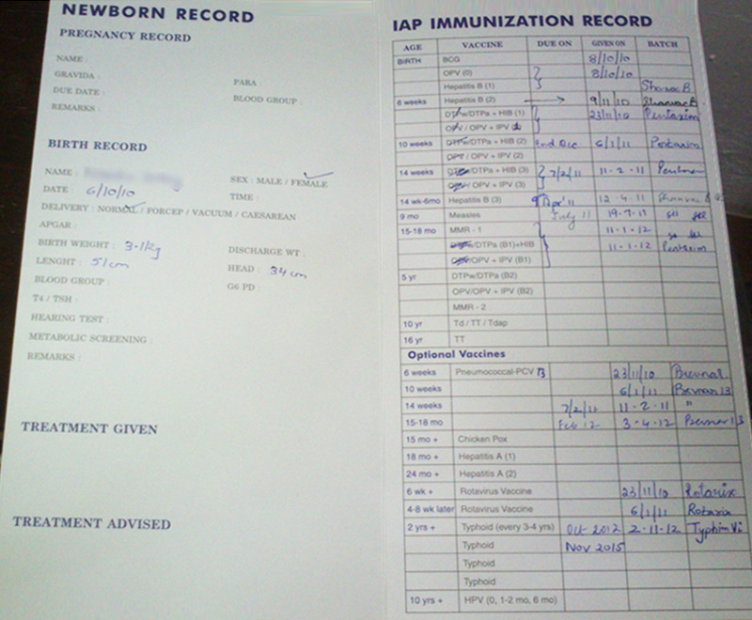

Slide 8
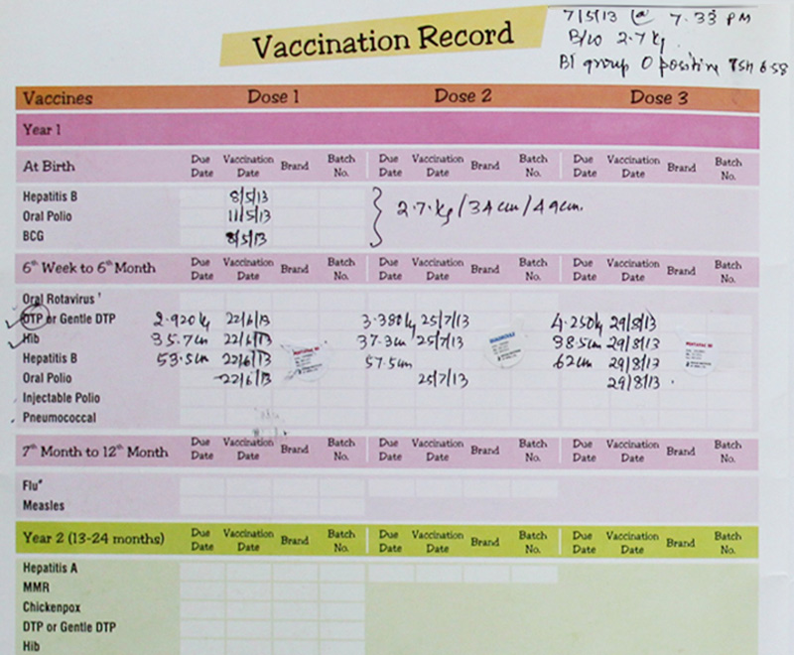

Slide 9
Proposed Systems:
The proposed system is a web-based application that reduces the paper work.
The system helps to book appointments for their child’s vaccination easily.
Parents can view their updates and also their reminders for appointments.
Secure access control and prevents misuse by unauthorized users.
The proposed system consists of web-based GUI and provides easy access to its user.
To create user friendly interface to operate for parents.
Fully validated to ensure correct and error free data entry.

Slide 10
INPUT OF THE SYSTEM:
The main input to the project is that the user login to the website “child vaccination” by entering the credential details and then the system helps to book appointments for their child’s vaccination easily.
Stock of the vaccine can be added.
Parents can view their updates and also their reminders for appointments.

Slide 11
OUTPUT OF THE SYSTEM:
This application provides a system to provide information store a record.
Help a parent’s schedule vaccination appointments for their children.
Admin will manage the child and vaccination report approval of the appointment.
Hospital will update the status of the vaccination applied for the child. with this application, a lot of man hours can be saved.

Slide 12
Advantages
It is easy to maintain.
It’s user-friendly.
The system helps to book appointments for their child’s vaccination easily.
Parents can view their updates and also their reminders for appointments.

Slide 13
System Description
The system comprises 2 major modules with their sub-modules as follows:
ADMIN:
Login: The admin can login to the system using a username and password.
View Hospitals
  Accept/Reject: They can view all the hospital details. Also, they can accept or reject the hospital’s application.
View Child Data: The admin can view all the child data
Appointment Details: All the appointment details can be viewed by the admin.
Export/Save Data: All the appointment data can be saved or exported by the admin.

Slide 14
PARENT:
Register: Parents will need to register first to log in with their basic details.
Login: They can log in using their username and password.
My profile: Also, they can make necessary changes to their profile details.
Change Password: They can easily change their old password to the new one.
Manage Child data: Parents can manage and view their child’s data, and also, they can add, update and delete these data.
Book Appointment: They can further book an appointment for their child’s vaccination.
View Appointments
  Details & Status: Parents can view appointment details and their status.
My Reminder: They can also view the appointment reminder.

Slide 15
Tools/platform, languages to be used:
Hardware requirements:
Processor : Intel core i3 processor
RAM : 4GB RAM / higher
Hard disk : 100GB above
Windows : 10 or above
Software requirements:
    Frond end : HTML, CSS, BOOTSTRAP, JAVASCRIPT.
    Back end : MYSQL
    Platform : Window OS
    Webserver : ApacheS2 server, Xamp server

Slide 16
Limitations of the project:
Parents will need to upload their child’s data correctly, otherwise, it will be led to the wrong output.
To keep the database up to date regular update is needed.
There is no particular booking of the system for child vaccines
Scope or future application of the project:
In future Android application can be developed.
Home schedule of vaccine can be added.
More modules on chatbot can be added.

Slide 17


